Slide 1
SECURED DATA TRANSFER WITH MULTI LAYERED SECURED ENCRYPTION STANDARDS USING ONION PROTOCOL
MOHAN RAJ S (211419205106)
JAGADESH E (211419205072)
GANESH N (211419205050)
DR.M. SUMITHRA

Slide 2
Objective & Scope
Enhancing the overall security of the system by providing multiple layers of encryption to protect sensitive data.
Providing robust protection against various types of attacks, such as brute force attacks, dictionary attacks, and other cryptographic attacks.
Developing an efficient and scalable encryption scheme that can be easily implemented across various platforms and devices.
Ensuring the confidentiality, integrity, and authenticity of data during transmission and storage.
Reducing the risk of data breaches, data theft, and unauthorized access to sensitive information.

Slide 3
Abstract
Because of the discoveries of global-scale widespread monitoring operations, Internet users are increasingly concerned about their privacy.
Nevertheless, for network service providers, this is normally undesirable since attackers would be able to anonymize themselves and bypass regulation while executing network attacks.
A multi-layered secured encryption standard using onion protocol was proposed in this project. We develop an effective security system which is used for secured data communication within the which collects Feedback about neighboring nodes transmitting the packets. Every node’s review is analyzed and best route is identified only the packets are transmitted.
Every Nodes while joins the network, two keys are generated. We also integrate multi level encryption model in this Project. If any wants to send the data to the desired destination, first our Project will find the available path to reach the destination.
Once the Path is identified, the data is first encrypted using RSA Algorithm from the source end then it is forwarded to the next node which finally leads to the destination.

Slide 4
Literature Survey
S.NO | NAME OF THE PAPER WITH YEAR | OBJECTIVE | PROS | CONS
1 | Multilayered Cryptography for Data Security in Cloud Computing (2018) | To propose a multilayered encryption scheme for securing data in cloud computing | Increased security due to multiple encryption layers; Low computational overhead | May increase latency due to multiple encryption layers
2 | Multilayered Encryption Approach for Secure Data Transmission in Wireless Sensor Networks (2020) | To propose a multilayered encryption approach for secure data transmission in wireless sensor networks | Improved security and privacy; Low computational overhead | Several encryption levels may cause latency to rise.

Slide 5
S.NO | NAME OF THE PAPER WITH YEAR | OBJECTIVE | PROS | CONS
3 | Multilayer Encryption System Based on DNA Sequence for Secure Communication (2021) | To propose a multilayer encryption system based on DNA sequence for secure communication | High security due to unique encryption keys; Efficient encryption and decryption | Requires specialized hardware for encryption and decryption
4 | Multilayer Encryption for Video Security and Privacy in IoT Environment (2021) | To propose a multilayer encryption scheme for securing video data in IoT environments | Improved security and privacy; Low computational overhead | May increase latency due to multiple encryption layers

Slide 6
S.NO | NAME OF THE PAPER WITH YEAR | OBJECTIVE | PROS | CONS
5 | A Multilayered Encryption Scheme for Securing Cloud Data in Big Data Environment (2019) | To propose a multilayered encryption scheme for securing cloud data in big data environment | High security due to multiple encryption layers; Low computational overhead | Several encryption levels may cause increased delay.
6 | A Multilayer Security Framework for Mobile Computing and Communication (2019) | To propose a multilayer security framework for mobile computing and communication | Provides comprehensive security measures for mobile devices; Allows for customizable levels of security | Increased complexity can lead to reduced performance; Requires careful management of security layers

Slide 7
S.NO | NAME OF THE PAPER WITH YEAR | OBJECTIVE | PROS | CONS
7 | Multilayer Data Encryption Using Symmetric and Asymmetric Cryptography (2020) | To develop a multilayer data encryption method using symmetric and asymmetric cryptography | Provides multiple layers of encryption for enhanced security; Uses a combination of strong symmetric and asymmetric encryption algorithms | Increased complexity can lead to reduced performance; Requires careful key management
8 | Multilayer Security for the Internet of Things (2018) | To propose a multilayer security architecture for the Internet of Things (IoT) | Provides a comprehensive security framework for IoT devices; Allows for customizable levels of security | Performance might suffer as a result of complexity, therefore security layers must be carefully managed.

Slide 8
S.NO | NAME OF THE PAPER WITH YEAR | OBJECTIVE | PROS | CONS
9 | Multilayer Encryption Model for Cloud Computing Security (2021) | To propose a multilayer encryption model for cloud computing security | Provides multiple layers of encryption for enhanced security; Allows for customizable levels of security | Performance may suffer as complexity rises, demanding careful layer management of security.
10 | Multilayered Security Approach for Web Applications (2019) | To propose a multilayered security approach for web applications | Provides comprehensive security measures for web applications; Allows for customizable levels of security | Increasing complexity may result in decreased performance; careful control of security layers is required.

Slide 9
Existing System
In the EXISTING SYSTEM, Most of the Times, Data are not properly transferred to the Destination, as there are more changes for Attacks from the Intermediate Hops.
In any Multi Hop Network system, Intermediate Node’s Support is mandatory. They should be Reliable for the effective data transfer.
But in most of the cases, in the existing system, it is not so. Either Intermediate itself will drop the packets the packets or it would be hacked.
We need to deploy IP Tracking system to track the misbehavior of any intermediate Nodes. It is Time consuming, not reliable and finally increasing the Network Traffic.

Slide 10
Disadvantages
Waiting time is increased
Unreliable
Packet Loss
Less effective
Less security

Slide 11
Proposed System
In Our Model, We deploy Multi Layer Secured protocol. Every node while registering, server will be provided with Id, primary key, secondary key and decryption key.
Data’s first encrypted using RSA algorithm and then with corresponding Master key of all the hops respectively. Intermediate Node’s ID is also Hashed for verification.
In the Proposed system, assuming we identify “C” is identified as the best Intermediate node that connects “A” the Source Node and “E” the Destination Node, first Data is encrypted using RSA Algorithm.
Then the same Data is encrypted using Master Key of Destination Node “E”, then again the same encrypted data is again Encrypted by the Master Key of Intermediate Node “C”.

Slide 12
Proposed System
Now this triple Encrypted data is transferred to the Intermediate Node “C”.
Now the “C” Node’s ID is verified and then its Secret Key is verified. After verification First layer of the data is decrypted.
Then it is forwarded to the destination Node “E”. Now second layer is decrypted by verifying the Secret Key of “E”.
Now finally the single layer is decrypted using “E” Node’s Decryption Key. Finally Original data is restored to the Destination Node “E”.

Slide 13
Advantages
Most Reliable
Assured data Transfer which ensures less time for Transfer.
Best Intermediate Node is identified Using Capacity Calculation

Slide 14
Hardware Requirements
Software Requirements
Processor : Core i3/i5/i7
RAM : 2-4GB
HDD : 500 GB
Platform : Windows 7 or above
Front End : Java-JDK1.7
Back End : MYSQL

Slide 15
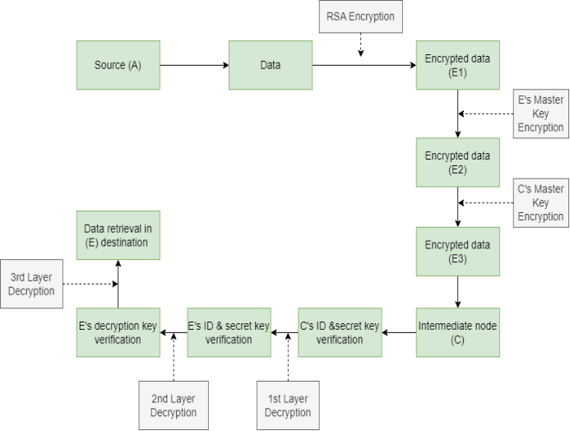
Architecture Diagram

Slide 16
Algorithm / Methodology
Algorithms Used:
RSA Algorithm
SHA-256 Algorithm
RSA Algorithm:
The primary characteristic of public-key cryptosystems is that the encryption and decryption processes use two separate keys—public key and private key—and that the private key cannot be derived from the public key.
This allows the publication of the encryption key without the risk of the secrets being leaked. The most important method of public key cryptography is RSA, which has so far shown to be virtually impervious to password assaults.

Slide 17
Algorithm / Methodology
1) Key generation:
a. Choose two random primes p and q of length K/2 bit .
b. Calculate the modulus, n, as n = p * q.
c. Calculate the totient, φ(n), as φ(n) = (p - 1) * (q - 1).
d. Choose an integer, e, such that 1 < e < φ(n) and gcd (e, φ(n)) = 1. This will be the public exponent.
e. Calculate the private exponent, d, as d ≡ e^(-1) (mod φ(n)). The extended Euclidean method can be utilised for this.
f. The public key consists of the modulus, n, and the public exponent, e. The private key consists of the modulus, n, and the private exponent, d.

Slide 18
Algorithm / Methodology
2) Encryption:
a. Choose a plaintext message, M, and convert it to a numerical value using a specified encoding scheme.
b. Calculate the ciphertext, C, as C ≡ Me (mod n).
3) Decryption:
a. Calculate the plaintext value, M, as M ≡ Cd (mod n).
b. Convert the numerical value back into the original message using the encoding scheme.

Slide 19
Algorithm / Methodology
SHA - 256 Algorithm:
SHA-256 (Secure Hash Algorithm 256-bit) is a cryptographic hash function that generates a fixed-length output of 256 bits, regardless of the size of the input data.
The steps involved in the SHA-256 algorithm can be summarized as follows:
Padding: The input message is padded with zeros to ensure that its length is a multiple of 512 bits.
Message Schedule: The padded message is divided into 512-bit blocks, and each block is further divided into 16 32-bit words.

Slide 20
Algorithm / Methodology
Initial Hash Values: The algorithm uses eight 32-bit values as initial hash values, which are obtained by taking the first 32 bits of the fractional parts of the square roots of the first eight prime numbers.
Compression Function: The compression function is applied to each 512-bit block of the padded message and the initial hash values. The function consists of several rounds, each of which performs a series of logical operations to transform the input values into output values.
Output: The output of the compression function is a 256-bit message digest that represents the input message.

Slide 21
Novelty
A multi-layered secured encryption standard using onion protocol was proposed in this project.
We develop an effective security system which is used for secured data communication within the which collects Feedback about neighboring nodes transmitting the packets.
Every node’s review is analyzed and best route is identified only the packets are transmitted.

Slide 22
Modules
Network construction
First level encryption
Multi layer encryption model
Decryption Process

Slide 23
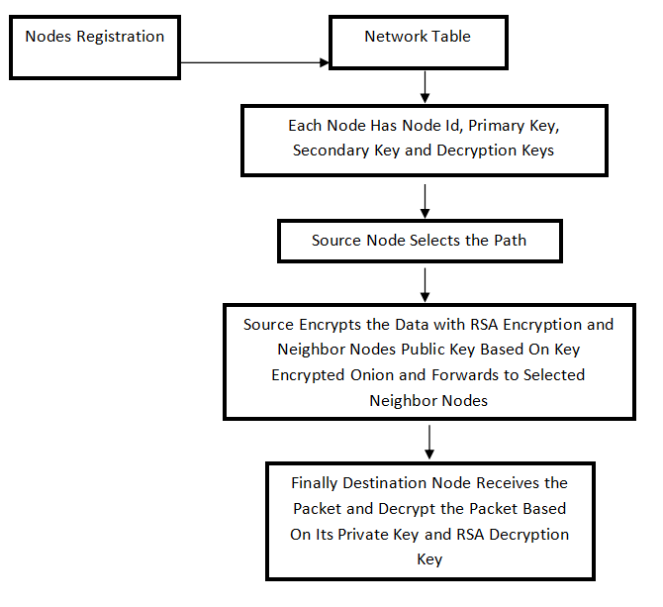
Module Description
Data Flow Diagram

Slide 24
Network Construction
In this Project concept, first we have to construct a network which consists of ‘n’ number of Nodes. So that nodes can request data from other nodes in the network. Since the Nodes have the mobility property, we can assume that the nodes are moving across the network. Network is used to store all the Nodes information like Node Id and other information. Each node is having primary key, secondary key and private key. Also network will monitor all the Nodes Communication for security purpose.

Slide 25
2. FIRST LEVEL ENCRYPTION
In this module the data which is to be transmitted from the source is first encrypted before sending it to the destination. The data security is ensured using this module. This encryption process is used as the initial Security process followed by multi security Encryption Process.

Slide 26
3. MULTI LAYER ENCRYPTION MODEL
In this Module, the main Project implementation of Multi Layer Security is achieved. After first level of Encryption, the same encrypted data is again encrypted by the Master Key of Destination Node and one another Encryption using Intermediate Node. Now this triple Encrypted data is transferred to the Intermediate Node. Now our System will verify the Intermediate Node’s ID and then its Secret Key. After verification First layer of the data is decrypted. Then it is forwarded to the destination Node. Now second layer is decrypted by verifying the Secret Key of Destination Node. Now finally the single layer is decrypted using Destination’s Decryption Key. Finally Original data is restored to the Destination Node.

Slide 27
4. DECRYPTION PROCESS
In this module, neighbor node decrypts the packet and finally sends to destination node. Then the destination node decrypts the packet with its private key and AES decryption key. Finally destination node views the original data. Since the paths capacity will vary dynamically, so that the paths will be changed dynamically as per data transfer along the network. So it increases the packet delivery ratio and decreases the average end-to-end delay.

Slide 28
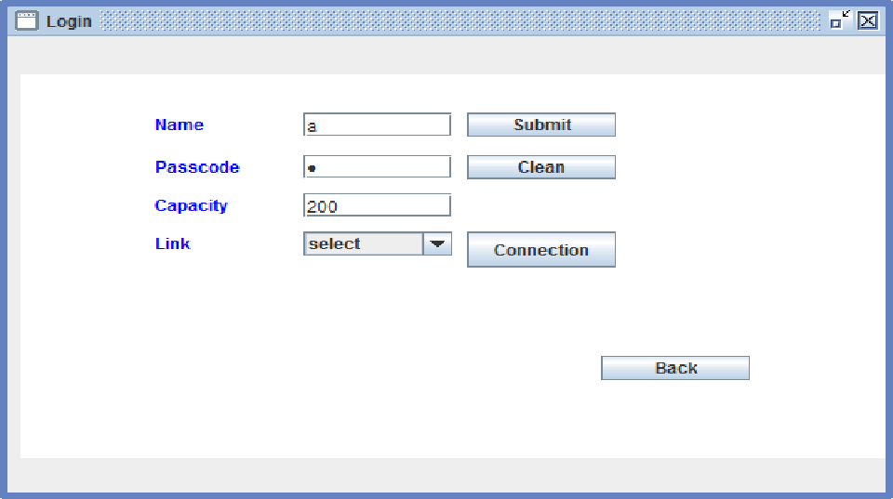



Snapshots
Key Generation
Node Generation

Slide 29

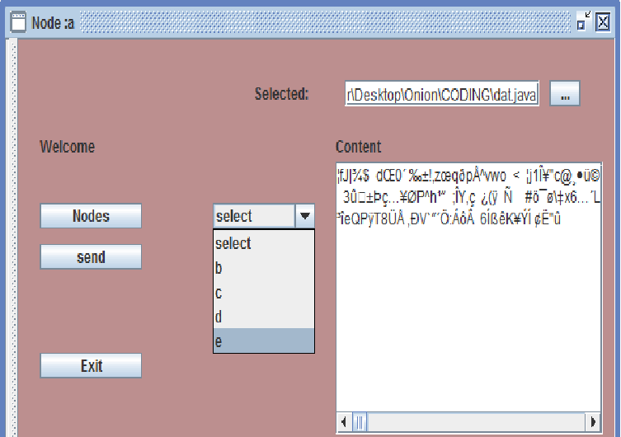
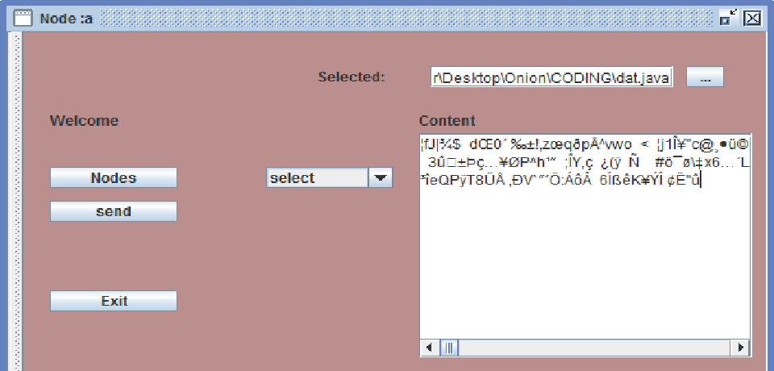
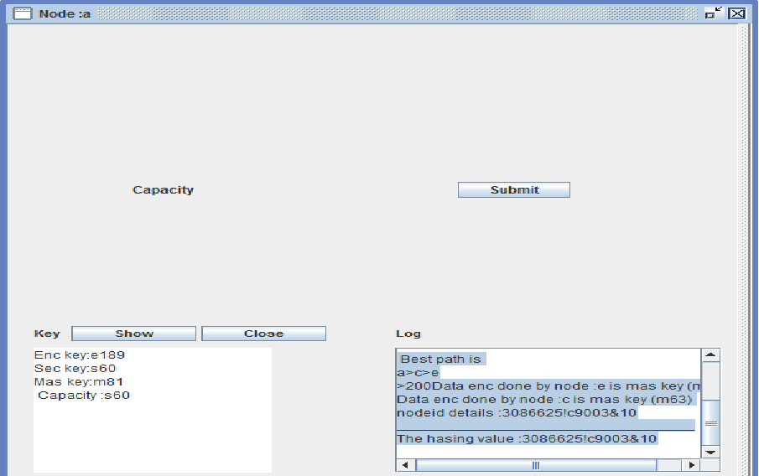
Encryption
Destination Selection
Path

Slide 30

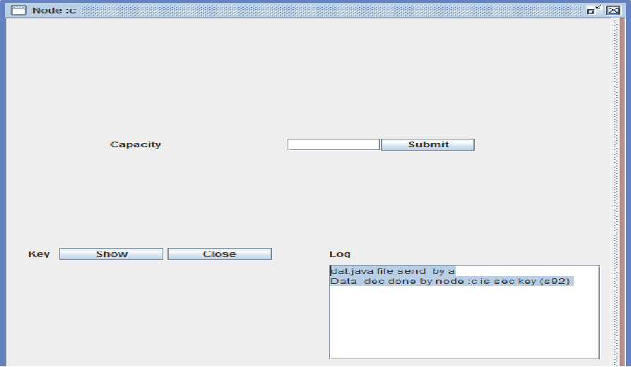
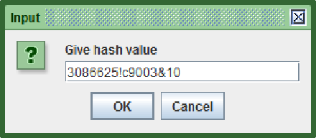

Decryption by Intermediate Node
Node Verification

Slide 31
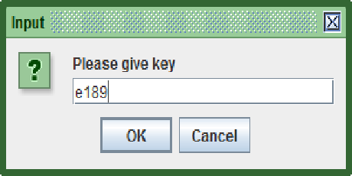
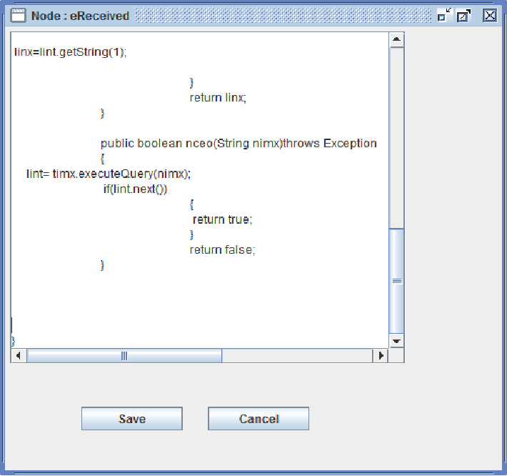

Destination Key Verification
Original Data

Slide 32
Sample Coding
Node Creation
import java.awt.*;
import java.awt.event.*;
import javax.swing.*;
import java.net.*;
import java.util.*;
public class ine extends JFrame
{
this.setSize(new Dimension(600,390));
this.setDefaultCloseOperation(DO_NOTHING_ON_CLOSE);
this.setResizable(xint);
}
/** Add Component Without a Layout Manager (Absolute Positioning) */
private void addComponent(Container mcot,Component cint,int intx,int inty,int
widx,int heim)
{
cint.setBounds(intx,inty,widx,heim);
mcot.add(cint);
}
private void logm_actionPerformed(ActionEvent eint)
{
try
{
uinx=lety.getText();
ncot=lcom.getText();
intf=inte.getText();
cost=asount.getText();//change
if(!uinx.equals("") || !ncot.equals(""))
{
fint.valid(uinx,ncot,intf,cost);
dispose();}}
}

Slide 33
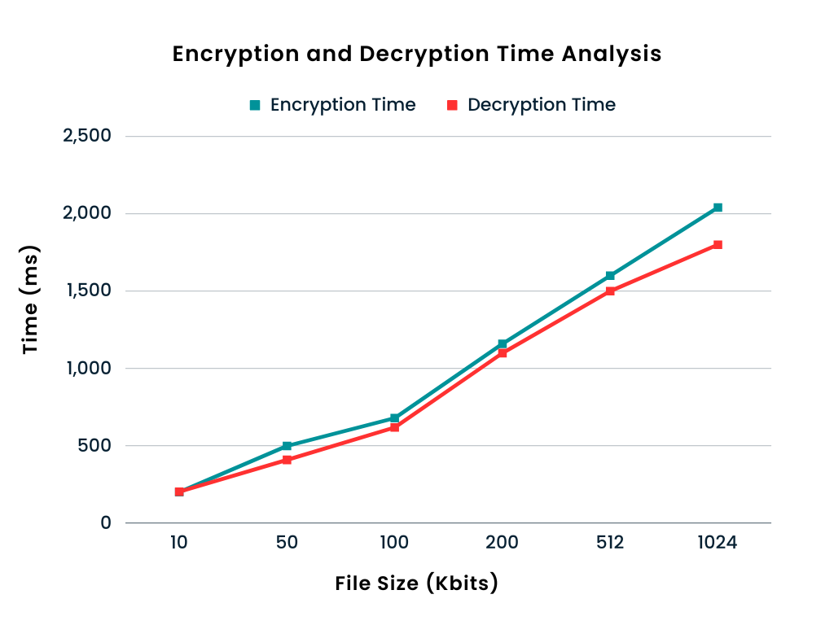
Performance measures of Proposed System
The data shows that the time required for both encryption and decryption grows as the file size does as well. This is due to the fact that processing bigger files takes longer and more computationally intensive. The fact that the decryption process requires more calculations than the encryption process contributes to the fact that the decryption time is often a little bit longer than the encryption time.
Also, it can be seen that as file size grows, the ratio of decryption to encryption time drops, suggesting that for bigger files, the decryption procedure is computationally less demanding than encryption.

Slide 34
Conclusion
In the Proposed Work, we can have implemented Multi Layer Security system for effective data Transfer from Source to destination through Multi Hop connectivity. We have a Complex Multilayer secured Protocol for highly secured data transfer. We also implemented Encryption of data using RSA apart from Multi Layer Encryption.
The Future work of this Project is dynamic route Connecting when any Intermediate Node is failed. Apart from Capacity calculation, we can also include Throughput, Energy for choosing Best Route / Hop for effective data Transfer.

Slide 35
References
[1] A. Kumar, A. Sinha, and R. K. Singh, "Multilayered Cryptography for Data Security in Cloud Computing," in IEEE International Conference on Computational Intelligence and Computing Research, 2018, pp. 1-6.
[2] M. S. Kumar and R. C. Bhagyaveni, "Multilayered Encryption Approach for Secure Data Transmission in Wireless Sensor Networks," in International Conference on Advanced Computing and Intelligent Engineering, 2020, pp. 101-107.
[3] W. Lu, X. Zhang, Y. Li, and Y. Li, "Multilayer Encryption System Based on DNA Sequence for Secure Communication," in IEEE Access, vol. 9, 2021, pp. 14396-14406.
[4] D. D. Dhanalakshmi and R. Kavitha, "Multilayer Encryption for Video Security and Privacy in IoT Environment," in International Journal of Innovative Technology and Exploring Engineering, vol. 10, no. 8, 2021, pp. 65-70.
[5] A. M. Narayanan and K. Srinivasan, "A Multilayered Encryption Scheme for Securing Cloud Data in Big Data Environment," in International Journal of Emerging Trends in Engineering Research, vol. 7, no. 1, 2019, pp. 456-462.
[6] R. Bhatia, A. K. Kalia, and K. Singh, "A Multilayer Security Framework for Mobile Computing and Communication," in 2019 International Conference on Computational Intelligence and Knowledge Economy (ICCIKE), 2019, pp. 196-201.
[7] N. M. Mubarak, M. H. M. Ali, and M. M. Idrus, "Multilayer Data Encryption Using Symmetric and Asymmetric Cryptography," in 2020 3rd International Conference on Intelligent Computing and Information Systems (ICICIS), 2020, pp. 129-134.

Slide 36
[8] K. M. A. Islam, A. Hossain, and M. A. H. Mamun, "Multilayer Security for the Internet of Things," in 2018 7th International Conference on Informatics, Electronics & Vision (ICIEV), 2018, pp. 536-541.
[9] S. Sivakumar and S. Chandrasekaran, "Multilayer Encryption Model for Cloud Computing Security," in 2021 6th International Conference on Computing, Communication and Security (ICCCS), 2021, pp. 1-6.
[10] S. B. G. Patil and V. N. Pawar, "Multilayered Security Approach for Web Applications," in 2019 IEEE International Conference on Computational Intelligence and Computing Research (ICCIC), 2019, pp. 1-5.
[11] Mrinal Kanti Sarkar, Rupayan Das,Dr. V S Dhaka, “Symmetric Key Based Design approach for Data Security in Cloud Computing,” National Conference of Cloud Computing and Big Data, pp.129-134, 2015.
[12] R. Bala Chandar, M. S. Kavitha , K. Seenivasan, “ A proficient model for high end security in cloud computing,” International Journal of Emerging Research in Management and Technology, vol.5(10), pp: 697-702, DOI: 10.21917/ijsc.2014.0100, 2014.
[13] Shakeeba S. Khan, R.R. Tuteja, ” Security in Cloud Computing using Cryptographic Algorithms,” International Journal of Innovative Research in Computer and Communication Engineering (An ISO 3297: 2007 Certified Organization) vol. 3( 1), pp. 148- 154, 2015.
[14] M.Gobi and Karthik Sundararaj, “ A Secured Cloud Security Using Elliptic Curve Cryptography,” Proceedings of the UGC Sponsored National Conference on Advanced Networking and Applications, pp.141-145, 2015.
[15] C. V. N. U. B. Murthy, M. L. Shri, S. Kadry and S. Lim, "Blockchain Based Cloud Computing: Architecture and Research Challenges," in IEEE Access, vol. 8, pp. 205190-205205, 2020, doi: 10.1109/ACCESS.2020.3036812.

